Slide 1
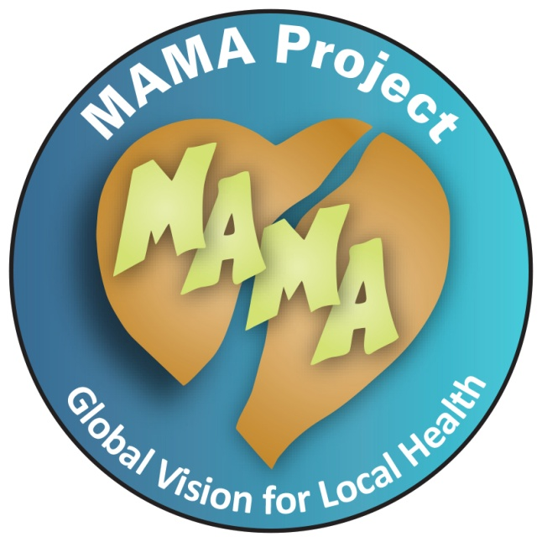
Vitamin A:
For Healthy Eyes and Bodies

Slide 2
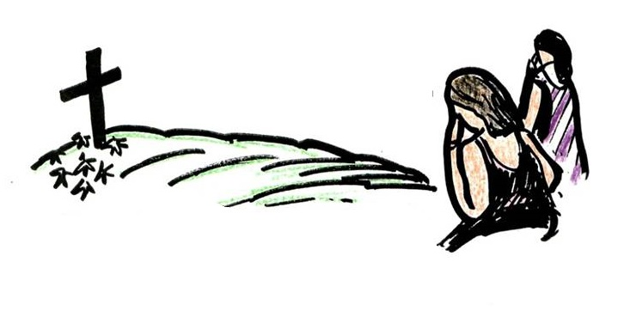
MALNUTRITION
Including Vitamin A deficiency
is one of the reasons that many children get sick and die.

Slide 3

Most malnourished children do not eat enough food
that is rich in
VITAMIN A

Slide 4

Vitamin A Deficiency
NERVOUS SYSTEM
EYES
TEETH
IMMUNOLOGICAL SYSTEM
RESPIRATORY SYSTEM
BLOOD
URINARY TRACT
DIGESTIVE SYSTEM
BONES
SKIN
Can harm the entire body.

Slide 5
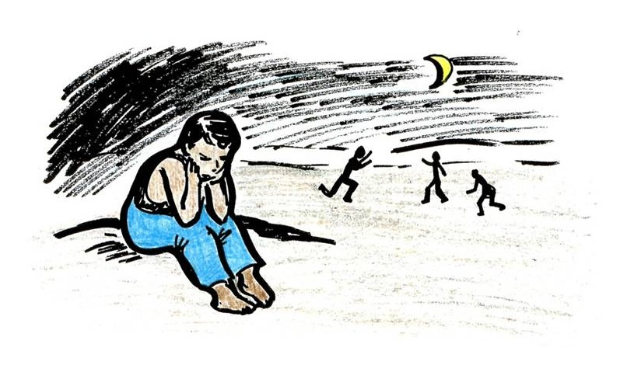
One of the first signs of Vitamin A deficiency can be
Night Blindness
A child who does not get enough Vitamin A may stop playing when daylight fades, even when other children are still active.

Slide 6

What are other danger signs in the eyes?
Dry eyes
Xerophthalmia
White spots
On the ball of the eyes
And Cloudy then Bulging Cornea

Slide 7
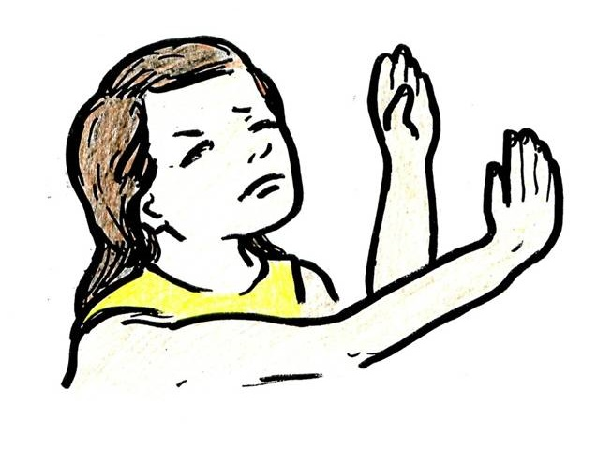
Vitamin A deficiency
Is the most common cause of permanent blindness in children in many countries.

Slide 8
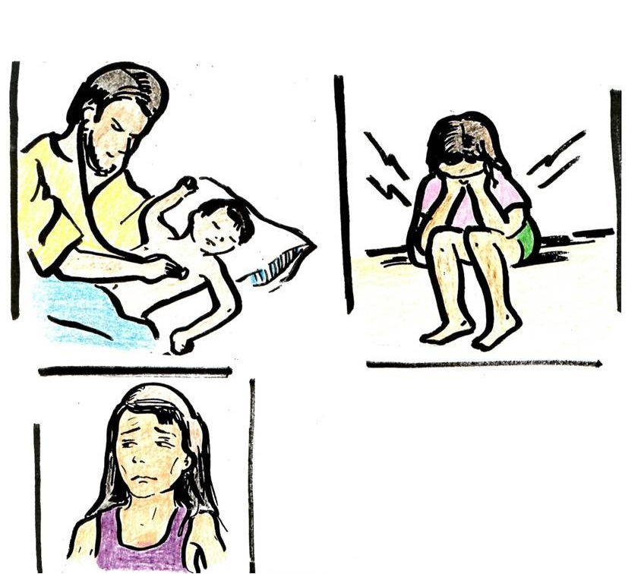
Children suffering from Vitamin A deficiency also suffer more:
Pneumonia
Diarrhea
Measles
and
Parasites

Slide 9

Mega doses of Vitamin A up to 200,000 IU capsules save the eyes and lives of children and are:
SAFE!
Children should never take more than 200,000 International Units per month, except in severe cases such as the measles, pneumonia, severe malnutrition or xerophthalmia (For children under 1 year a maximum of 100,000 IU)
A record of the Vitamin A usage should be kept.
Pregnant women should never take vitamin A in mega doses, but they should eat a diet rich in Vitamin A.
After childbirth they can take a capsule.
BUT INTOXICATION CAN OCCUR IF USED IMPROPERLY

Slide 10

Another way to combat Vitamin A Deficiency is
Vitamin A Sugar fortification
This can and does save the sight and the lives of many children.

Slide 11

When a child who is malnourished especially with Vitamin A deficiency becomes sick with diarrhea, pneumonia or measles that child has a higher risk or dying or becoming
PERMANENTLY BLIND

Slide 12
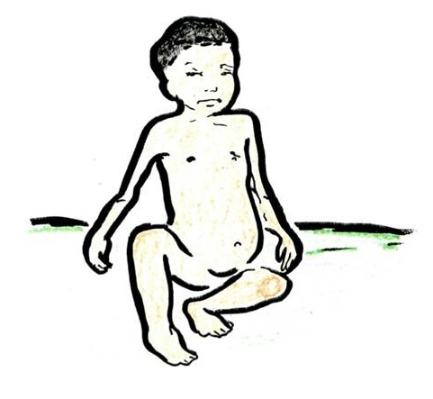
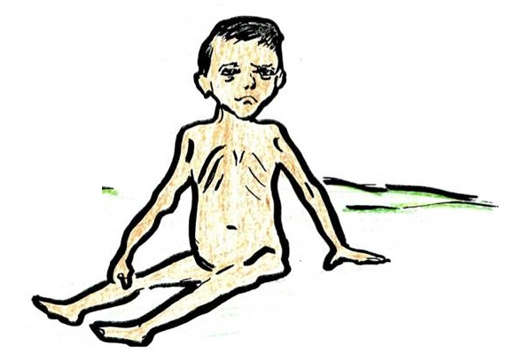
There are different types of severe malnutrition
Marasmus
Kwashiorkor

Slide 13
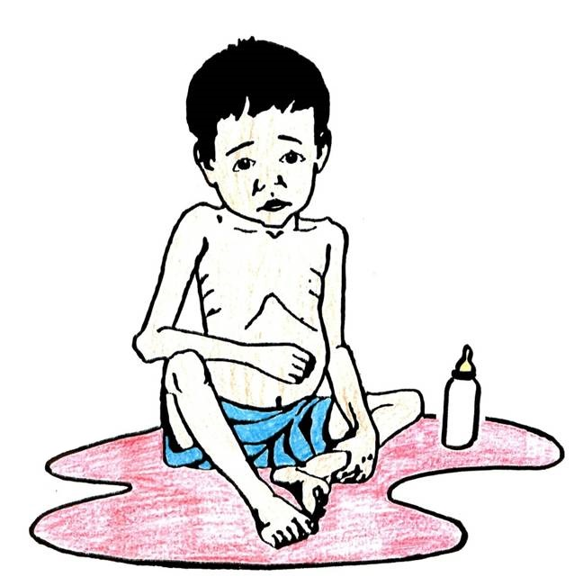
There is a higher risk of malnutrition for:
Children of undernourished mothers
Children fed with a bottle instead of breast fed
Children from 6 months to 6 years old
Children who in their homes do not have sufficient clean water and sanitary latrines.

Slide 14
Severe malnutrition is very dangerous, but sometimes children actually look normal even when they are failing to get enough food that is rich in vitamins and minerals called MICRONUTRIENTS.
We call this “HIDDEN HUNGER”
It is more common than severe malnutrition, and is the biggest cause of preventable death from infection in children around the world.
We can combat HIDDEN HUNGER in many ways - Including fortifying food in the home, eating eggs, fruits, vegetables, and using vitamin A capsules

Slide 15

VITAMIN A MEGADOSE CAPSULE
Treatment to Follow
Children with “xerophthalmia”:
Immediately provide 200,000 (UI) of Vitamin A capsule orally (100,000 for children under one year old). Tomorrow- repeat dose. Repeat dose again for 1 to 4 weeks.
Children with frequent diarrhea, measles, minor respiratory infection or severe malnutrition:
200,000 (UI) of Vitamin A in capsule orally (100,000 for children under 1 year of age)
Preventative dose:
Children (1 year and older) take 200,000 UI Vitamin A every 3-6 months
Infants (6-12 months) 100,000 UI of Vitamin A orally every 3-6 months (1/2 of a 200,000 UI capsule)

Slide 16



What can families do to improve their diet?
Use iodized salt.
Breed cows, goats and rabbits.
Create family gardens.
Breed chickens or guineas to have meat and eggs.
Breastfeeding.
Raise or catch fish.
Do not drink liquor or smoke.

Slide 17
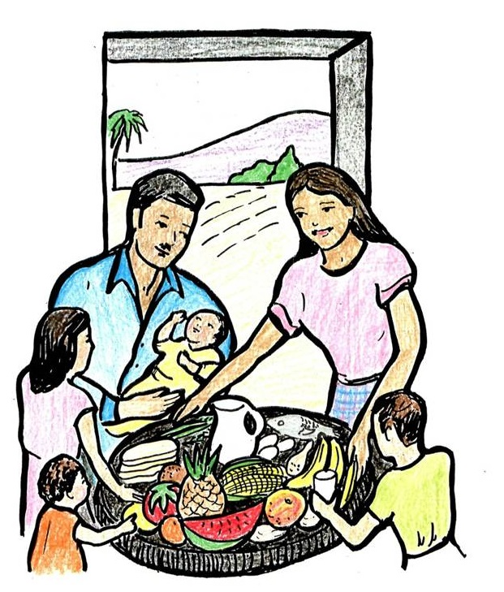
What foods can we start giving children 6 months and older?
Foods rich in Vitamin A along with proteins and fats.
Papayas
Milk
Mangos
Red Palm Oil
Soybeans
Leafy Greens and Vegetables
Beans
Rice
Butter
Corn
Wild plants (Bedo or Amaranth)
Eggs
Meat
Cheese
Small and infant children need proteins like eggs and beans for growth, and fats like oil so that their brains are developed for maximum intelligence.

