Slide 1

The Fight Against Hunger

Slide 2
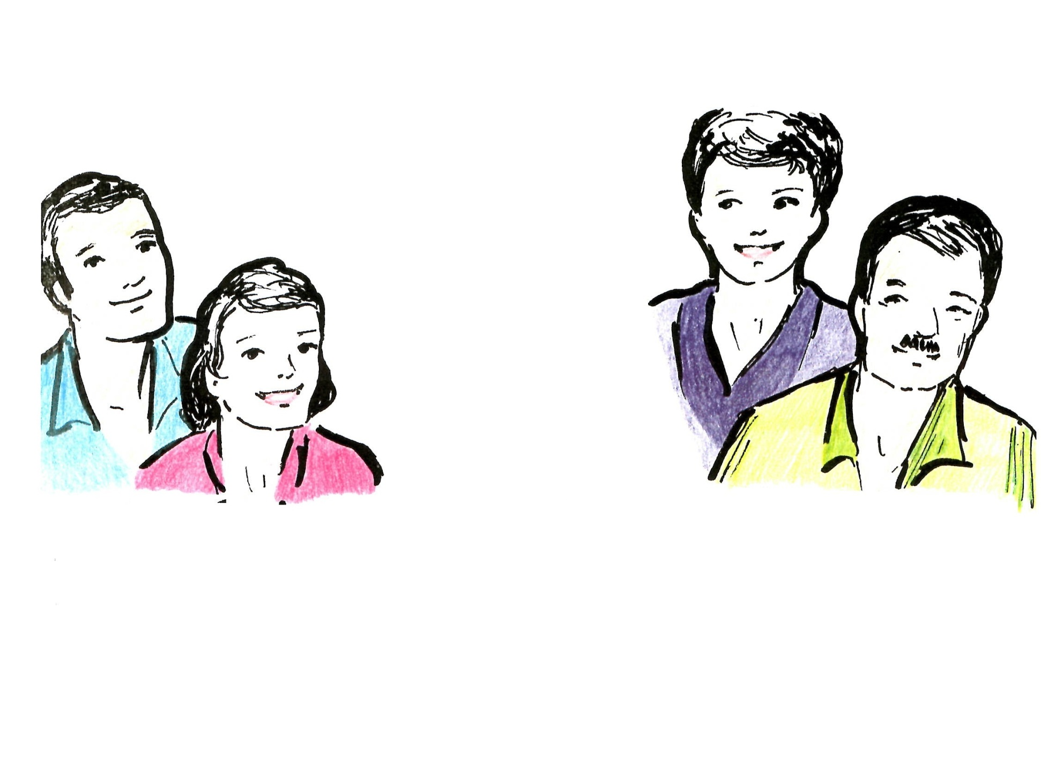
Hello
We work with MAMA Project and with the communities for the
“fight against hunger”.

Slide 3
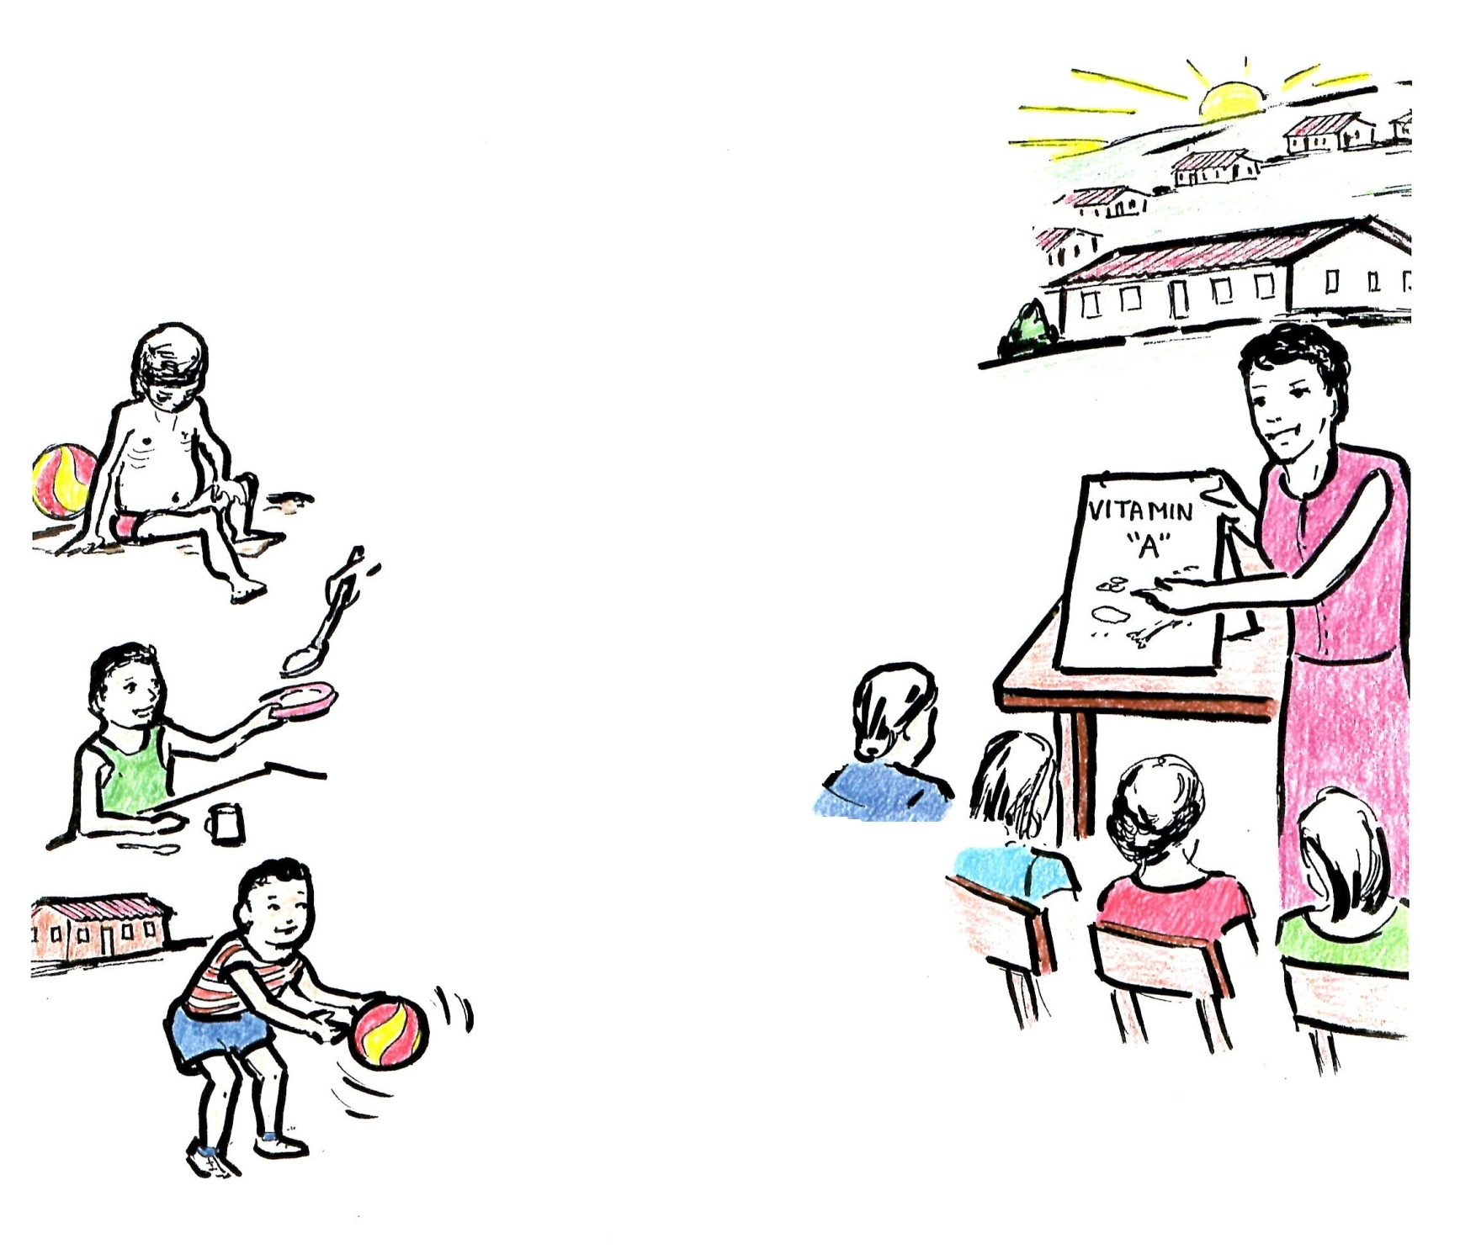
What is the MAMA Project?
It is an effort of friendship and Christian love
Coordinated by:
  Agencies
  Churches
  Businesses
  Schools
  Clinics
  The health authorities
  The town
We face hunger and we encourage a healthy and abundant life – according to God’s will for humanity.

Slide 4
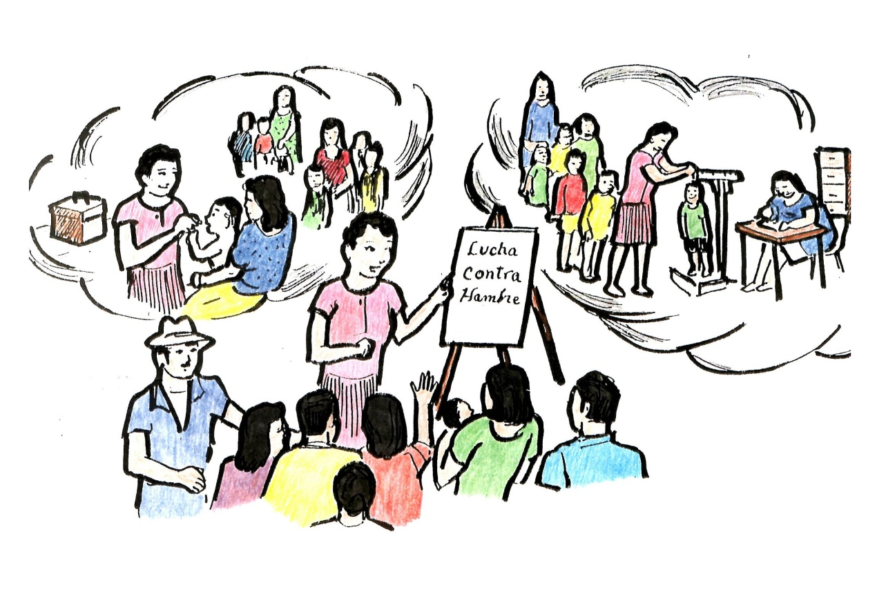
We coordinate campaigns with the communities.
If we are going to succeed,
it is necessary that the entire community participates.

Slide 5
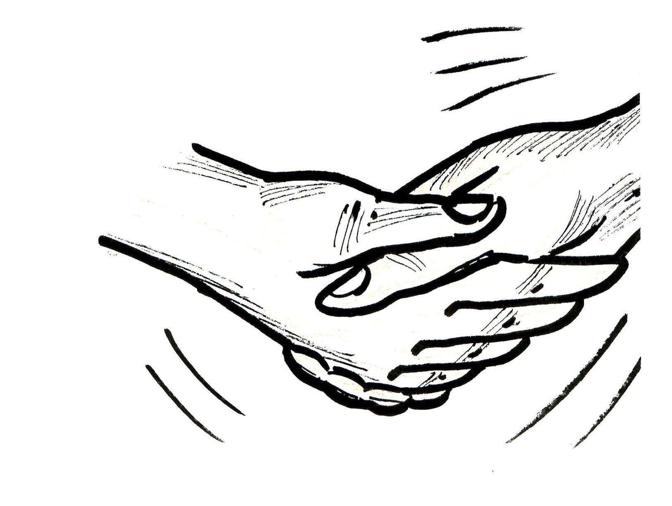
The Fight Against Hunger Needs:
The whole community
Politicians
Agencies
Clubs
Businesses – large and small
The children, the mothers, the fathers, and the elderly

Slide 6

THE STRATEGY:
Community Activities
De-worming
Distribution of Vitamin A to the children
Gardens
Personal and village hygiene
Better diet

Slide 7
CAMPAIGNS
Education to change the habits and customs
Educational talks
Deworming
Vitamin A
Filtration and chlorination of water

Slide 8
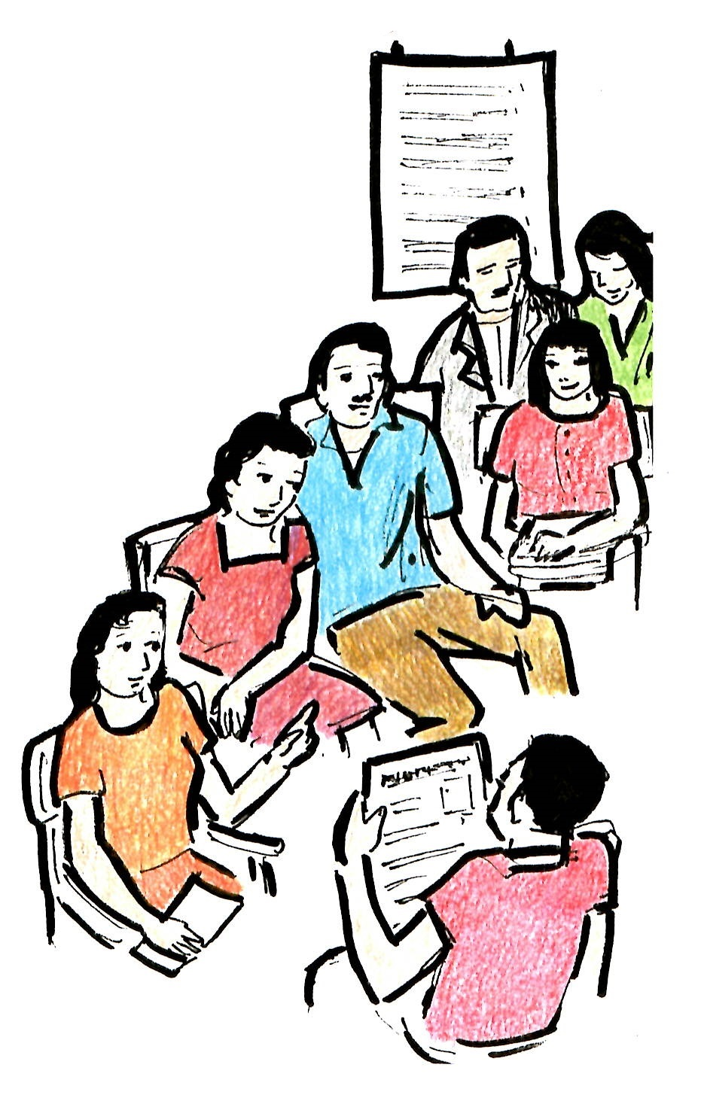
COMMUNITY ACTIVITIES
Each community can carry out activities to work together with the community leaders, health officials, schools, and other groups. These activities can help:
Evaluate your community – your resources and your
problems
Take a census of the population of your
village
Observe the growth of the children to know
how many are healthy and how many are
malnourished and what is the degree of
malnutrition
Have seminars, trainings, and orientations
Learn from the elderly: for example,
to recognize edible wild plants to improve the diet
of the malnourished children
Facilitate and promote campaigns of environmental
Hygiene, de-worming, and distribution of Vitamin A.

Slide 9

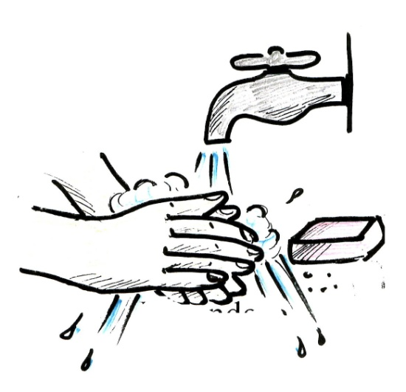
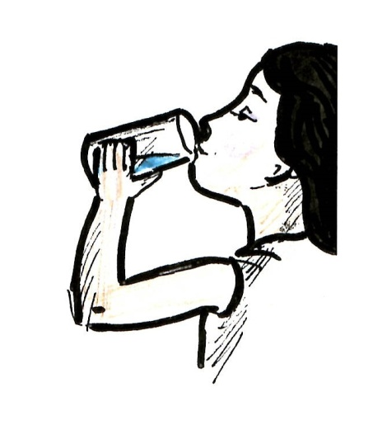
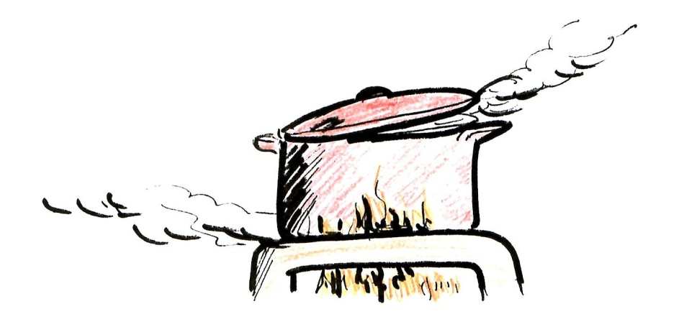
Examples of Important Messages
Use
Latrines
Wash Hands
Boil Water
Filter and Chlorinate the Water
OR

Slide 10
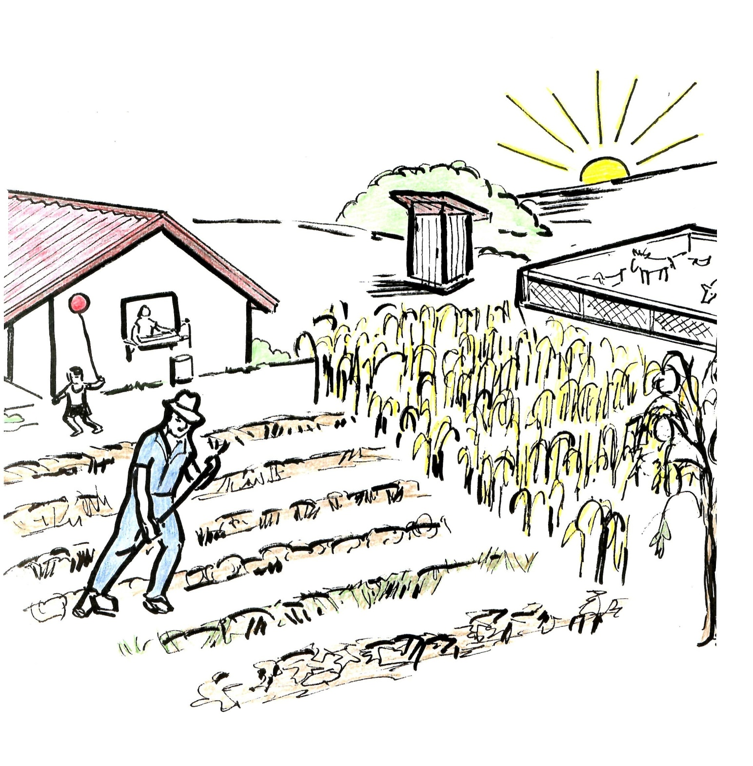
To Have Gardens

Slide 11
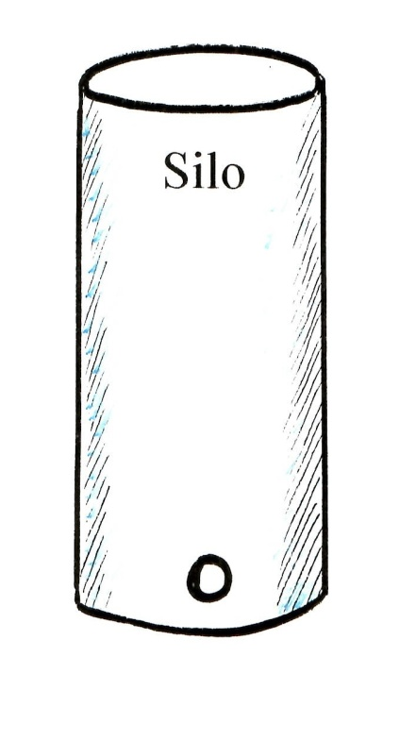
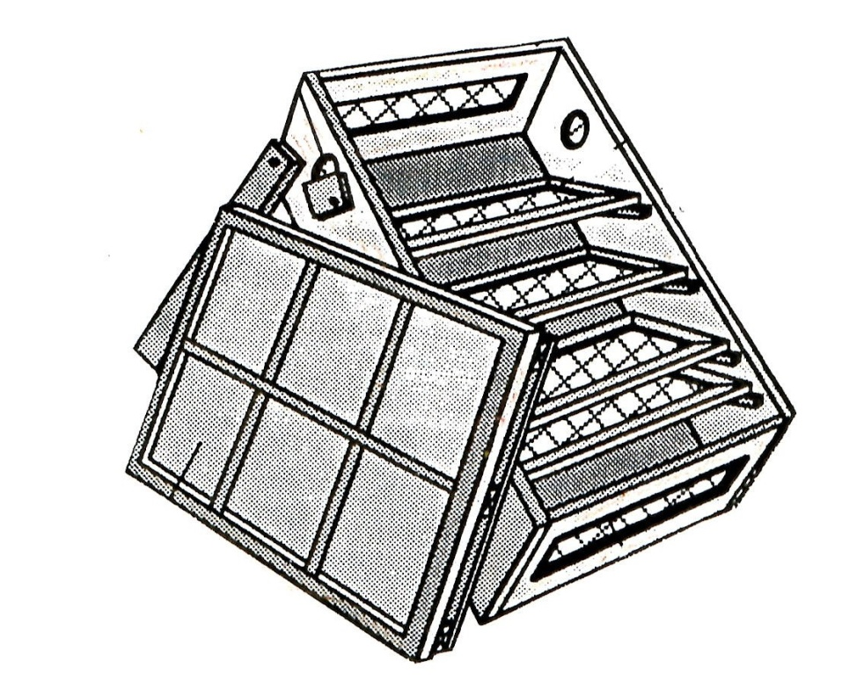
What are some ideas to work on for the future?
Crop Conservation
Solar dryer for food

Slide 12


There are simple habits that can be added to a daily routine to improve Vitamin A health:
Consumption of sugar enriched with Vitamin A
Consumption of salt with iodine

Slide 13
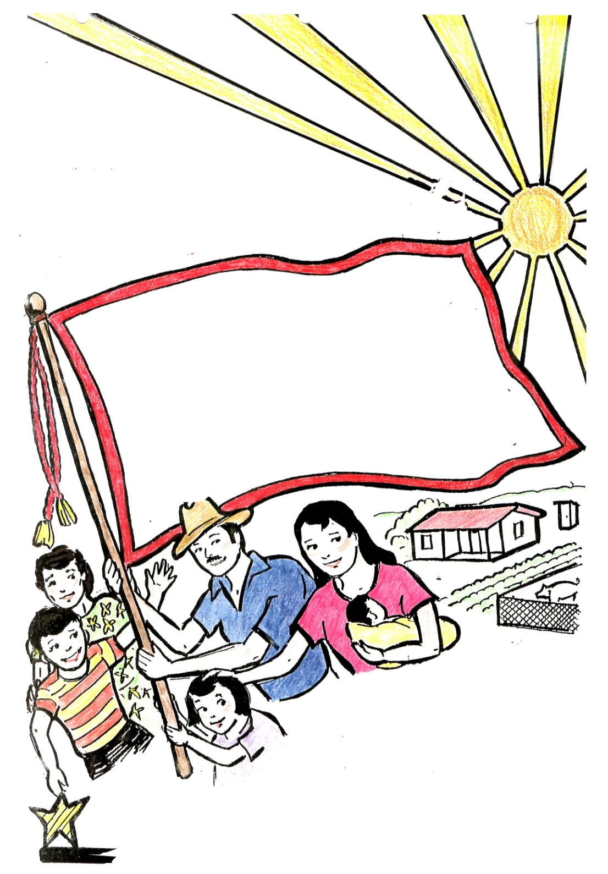
We Will Win The Fight Against
Hunger!

